Slide 1
Using Quotations
Presentation: IMKessel
Text: Owl.English.Perdue
(Sean M. Conrey, Mark Pepper, Allen Brizee)
Notes:
https://owl.english.purdue.edu/owl/resource/577/01/

Slide 2
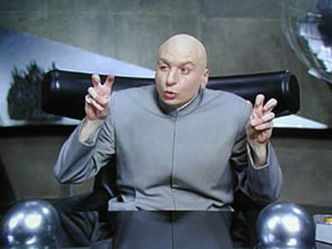
How to Use Quotation Marks
The primary function of quotation marks
is to set off and represent exact language
(either spoken or written) that has come from somebody else. The quotation mark is also used to designate speech acts in fiction and sometimes poetry. Since you will most often use them when working with outside sources, successful use of quotation marks is a practical defense against accidental plagiarism and an excellent practice in academic honesty. The following rules of quotation mark use are the standard in the United States, although it may be of interest that usage rules for this punctuation do vary in other countries.
Notes:
How to Use Quotation Marks
Summary:
A rundown of the general rules of when and where to use quotation marks.
Contributors:Sean M. Conrey, Mark Pepper, Allen Brizee Last Edited: 2013-04-18 08:14:53
Using Quotation Marks
The primary function of quotation marks is to set off and represent exact language (either spoken or written) that has come from somebody else. The quotation mark is also used to designate speech acts in fiction and sometimes poetry. Since you will most often use them when working with outside sources, successful use of quotation marks is a practical defense against accidental plagiarism and an excellent practice in academic honesty. The following rules of quotation mark use are the standard in the United States, although it may be of interest that usage rules for this punctuation do vary in other countries.
The following covers the basic use of quotation marks. For details and exceptions consult the separate sections of this guide.
Direct Quotations
Direct quotations involve incorporating another person's exact words into your own writing.
1. Quotation marks always come in pairs. Do not open a quotation and fail to close it at the end of the quoted material.
2. Capitalize the first letter of a direct quote when the quoted material is a complete sentence.
Mr. Johnson, who was working in his field that morning, said, "The alien spaceship appeared right before my own two eyes."
3. Do not use a capital letter when the quoted material is a fragment or only a piece of the original material's complete sentence.
Although Mr. Johnson has seen odd happenings on the farm, he stated that the spaceship "certainly takes the cake" when it comes to unexplainable activity.
4. If a direct quotation is interrupted mid-sentence, do not capitalize the second part of the quotation.
"I didn't see an actual alien being," Mr. Johnson said, "but I sure wish I had."
5. In all the examples above, note how the period or comma punctuation always comes before the final quotation mark. It is important to realize also that when you are using MLA or some other form of documentation, this punctuation rule may change.
When quoting text with a spelling or grammar error, you should transcribe the error exactly in your own text. However, also insert the term sic in italics directly after the mistake, and enclose it in brackets. Sic is from the Latin, and translates to "thus," "so," or "just as that." The word tells the reader that your quote is an exact reproduction of what you found, and the error is not your own.
Mr. Johnson says of the experience, "It's made me reconsider the existence of extraterestials [sic]."
6. Quotations are most effective if you use them sparingly and keep them relatively short. Too many quotations in a research paper will get you accused of not producing original thought or material (they may also bore a reader who wants to know primarily what YOU have to say on the subject).
Indirect Quotations
Indirect quotations are not exact wordings but rather rephrasings or summaries of another person's words. In this case, it is not necessary to use quotation marks. However, indirect quotations still require proper citations, and you will be commiting plagiarism if you fail to do so.
Mr. Johnson, a local farmer, reported last night that he saw an alien spaceship on his own property.
Many writers struggle with when to use direct quotations versus indirect quotations. Use the following tips to guide you in your choice.
Use direct quotations when the source material uses language that is particularly striking or notable. Do not rob such language of its power by altering it.
Martin Luther King Jr. believed that the end of slavery was important and of great hope to millions of slaves done horribly wrong.
The above should never stand in for:
Martin Luther King Jr. said of the Emancipation Proclamation, "This momentous decree came as a great beacon light of hope to millions of Negro slaves who had been seared in the flames of withering injustice."
Use an indirect quotation (or paraphrase) when you merely need to summarize key incidents or details of the text.
Use direct quotations when the author you are quoting has coined a term unique to her or his research and relevant within your own paper.
When to use direct quotes versus indirect quotes is ultimately a choice you'll learn a feeling for with experience. However, always try to have a sense for why you've chosen your quote. In other words, never put quotes in your paper simply because your teacher says, "You must use quotes."

Slide 3
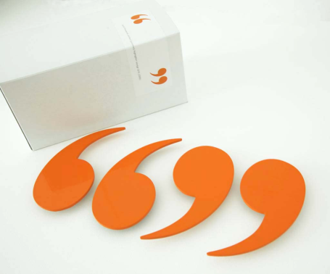
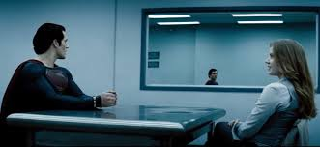
Direct Quotations
Direct quotations involve incorporating another person's exact words into your own writing.
Quotation marks always come in pairs. Do not open a quotation and fail to close it at the end of the quoted material.
Notes:
Direct Quotations
Direct quotations involve incorporating another person's exact words into your own writing.
1. Quotation marks always come in pairs. Do not open a quotation and fail to close it at the end of the quoted material.
2. Capitalize the first letter of a direct quote when the quoted material is a complete sentence.
Mr. Johnson, who was working in his field that morning, said, "The alien spaceship appeared right before my own two eyes."
3. Do not use a capital letter when the quoted material is a fragment or only a piece of the original material's complete sentence.
Although Mr. Johnson has seen odd happenings on the farm, he stated that the spaceship "certainly takes the cake" when it comes to unexplainable activity.
4. If a direct quotation is interrupted mid-sentence, do not capitalize the second part of the quotation.
"I didn't see an actual alien being," Mr. Johnson said, "but I sure wish I had."
5. In all the examples above, note how the period or comma punctuation always comes before the final quotation mark. It is important to realize also that when you are using MLA or some other form of documentation, this punctuation rule may change.
When quoting text with a spelling or grammar error, you should transcribe the error exactly in your own text. However, also insert the term sic in italics directly after the mistake, and enclose it in brackets. Sic is from the Latin, and translates to "thus," "so," or "just as that." The word tells the reader that your quote is an exact reproduction of what you found, and the error is not your own.
Mr. Johnson says of the experience, "It's made me reconsider the existence of extraterestials [sic]."
6. Quotations are most effective if you use them sparingly and keep them relatively short. Too many quotations in a research paper will get you accused of not producing original thought or material (they may also bore a reader who wants to know primarily what YOU have to say on the subject).
Indirect Quotations
Indirect quotations are not exact wordings but rather rephrasings or summaries of another person's words. In this case, it is not necessary to use quotation marks. However, indirect quotations still require proper citations, and you will be commiting plagiarism if you fail to do so.
Mr. Johnson, a local farmer, reported last night that he saw an alien spaceship on his own property.
Many writers struggle with when to use direct quotations versus indirect quotations. Use the following tips to guide you in your choice.
Use direct quotations when the source material uses language that is particularly striking or notable. Do not rob such language of its power by altering it.
Martin Luther King Jr. believed that the end of slavery was important and of great hope to millions of slaves done horribly wrong.
The above should never stand in for:
Martin Luther King Jr. said of the Emancipation Proclamation, "This momentous decree came as a great beacon light of hope to millions of Negro slaves who had been seared in the flames of withering injustice."
Use an indirect quotation (or paraphrase) when you merely need to summarize key incidents or details of the text.
Use direct quotations when the author you are quoting has coined a term unique to her or his research and relevant within your own paper.
When to use direct quotes versus indirect quotes is ultimately a choice you'll learn a feeling for with experience. However, always try to have a sense for why you've chosen your quote. In other words, never put quotes in your paper simply because your teacher says, "You must use quotes."

Slide 4
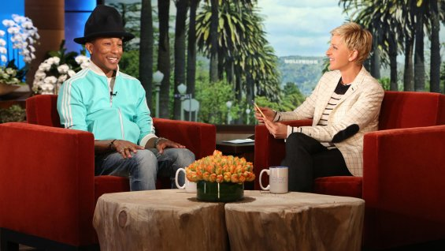
Direct Quotations
2. Capitalize the first letter of a direct quote when the quoted material is a complete sentence.
Mr. Johnson, who was working in his field that morning, said, "The alien spaceship appeared right before my own two eyes."
Notes:
Direct Quotations
Direct quotations involve incorporating another person's exact words into your own writing.
1. Quotation marks always come in pairs. Do not open a quotation and fail to close it at the end of the quoted material.
2. Capitalize the first letter of a direct quote when the quoted material is a complete sentence.
Mr. Johnson, who was working in his field that morning, said, "The alien spaceship appeared right before my own two eyes."
3. Do not use a capital letter when the quoted material is a fragment or only a piece of the original material's complete sentence.
Although Mr. Johnson has seen odd happenings on the farm, he stated that the spaceship "certainly takes the cake" when it comes to unexplainable activity.
4. If a direct quotation is interrupted mid-sentence, do not capitalize the second part of the quotation.
"I didn't see an actual alien being," Mr. Johnson said, "but I sure wish I had."
5. In all the examples above, note how the period or comma punctuation always comes before the final quotation mark. It is important to realize also that when you are using MLA or some other form of documentation, this punctuation rule may change.
When quoting text with a spelling or grammar error, you should transcribe the error exactly in your own text. However, also insert the term sic in italics directly after the mistake, and enclose it in brackets. Sic is from the Latin, and translates to "thus," "so," or "just as that." The word tells the reader that your quote is an exact reproduction of what you found, and the error is not your own.
Mr. Johnson says of the experience, "It's made me reconsider the existence of extraterestials [sic]."
6. Quotations are most effective if you use them sparingly and keep them relatively short. Too many quotations in a research paper will get you accused of not producing original thought or material (they may also bore a reader who wants to know primarily what YOU have to say on the subject).
Indirect Quotations
Indirect quotations are not exact wordings but rather rephrasings or summaries of another person's words. In this case, it is not necessary to use quotation marks. However, indirect quotations still require proper citations, and you will be commiting plagiarism if you fail to do so.
Mr. Johnson, a local farmer, reported last night that he saw an alien spaceship on his own property.
Many writers struggle with when to use direct quotations versus indirect quotations. Use the following tips to guide you in your choice.
Use direct quotations when the source material uses language that is particularly striking or notable. Do not rob such language of its power by altering it.
Martin Luther King Jr. believed that the end of slavery was important and of great hope to millions of slaves done horribly wrong.
The above should never stand in for:
Martin Luther King Jr. said of the Emancipation Proclamation, "This momentous decree came as a great beacon light of hope to millions of Negro slaves who had been seared in the flames of withering injustice."
Use an indirect quotation (or paraphrase) when you merely need to summarize key incidents or details of the text.
Use direct quotations when the author you are quoting has coined a term unique to her or his research and relevant within your own paper.
When to use direct quotes versus indirect quotes is ultimately a choice you'll learn a feeling for with experience. However, always try to have a sense for why you've chosen your quote. In other words, never put quotes in your paper simply because your teacher says, "You must use quotes."

Slide 5
Direct Quotations
3. Do not use a capital letter when the quoted material is a fragment or only a piece of the original material's complete sentence.
Although Mr. Johnson has seen odd happenings on the farm, he stated that the spaceship "certainly takes the cake" when it comes to unexplainable activity.

Slide 6
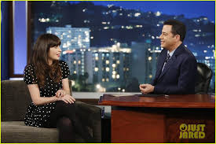
Direct Quotations
4. If a direct quotation is interrupted mid-sentence, do not capitalize the second part of the quotation.
"I didn't see an actual alien being," Mr. Johnson said, "but I sure wish I had."

Slide 7
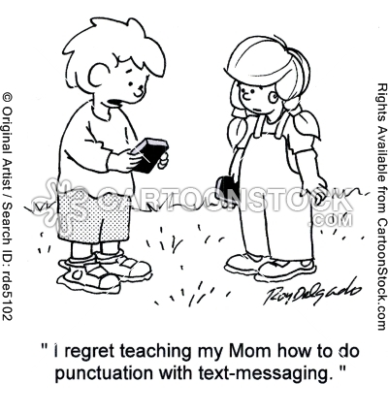
Direct Quotations
5. In all the examples above, note how the period or comma punctuation always comes before the final quotation mark.
It is important to realize also
That when you are using MLA
or some other form of
documentation, this
punctuation rule may change.

Slide 8
Direct Quotations
6. Quotations are most effective if you use them sparingly and keep them relatively short. Too many quotations in a research paper will get you accused of not producing original thought or material (they may also bore a reader who wants to know primarily what YOU have to say on the subject).
Quote from the text, but
don’t cut and paste so that
someone else’s words speak for
you.
Notes:
6. Quotations are most effective if you use them sparingly and keep them relatively short. Too many quotations in a research paper will get you accused of not producing original thought or material (they may also bore a reader who wants to know primarily what YOU have to say on the subject).
Indirect Quotations
Indirect quotations are not exact wordings but rather rephrasings or summaries of another person's words. In this case, it is not necessary to use quotation marks. However, indirect quotations still require proper citations, and you will be commiting plagiarism if you fail to do so.
Mr. Johnson, a local farmer, reported last night that he saw an alien spaceship on his own property.
Many writers struggle with when to use direct quotations versus indirect quotations. Use the following tips to guide you in your choice.
Use direct quotations when the source material uses language that is particularly striking or notable. Do not rob such language of its power by altering it.
Martin Luther King Jr. believed that the end of slavery was important and of great hope to millions of slaves done horribly wrong.
The above should never stand in for:
Martin Luther King Jr. said of the Emancipation Proclamation, "This momentous decree came as a great beacon light of hope to millions of Negro slaves who had been seared in the flames of withering injustice."
Use an indirect quotation (or paraphrase) when you merely need to summarize key incidents or details of the text.
Use direct quotations when the author you are quoting has coined a term unique to her or his research and relevant within your own paper.
When to use direct quotes versus indirect quotes is ultimately a choice you'll learn a feeling for with experience. However, always try to have a sense for why you've chosen your quote. In other words, never put quotes in your paper simply because your teacher says, "You must use quotes."

Slide 9
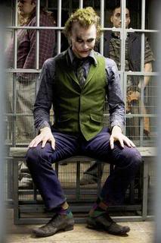
Indirect Quotations
Indirect quotations are not exact wordings but rather rephrasings or summaries of another person's words. In this case, it is not necessary to use quotation marks. However, indirect quotations still require proper citations, and you will be committing plagiarism if you fail to do so.
Mr. Johnson, a local farmer, reported last night
that he saw an alien spaceship on his own
property.
Notes:
Indirect Quotations
Indirect quotations are not exact wordings but rather rephrasings or summaries of another person's words. In this case, it is not necessary to use quotation marks. However, indirect quotations still require proper citations, and you will be commiting plagiarism if you fail to do so.
Mr. Johnson, a local farmer, reported last night that he saw an alien spaceship on his own property.
Many writers struggle with when to use direct quotations versus indirect quotations. Use the following tips to guide you in your choice.
Use direct quotations when the source material uses language that is particularly striking or notable. Do not rob such language of its power by altering it.
Martin Luther King Jr. believed that the end of slavery was important and of great hope to millions of slaves done horribly wrong.
The above should never stand in for:
Martin Luther King Jr. said of the Emancipation Proclamation, "This momentous decree came as a great beacon light of hope to millions of Negro slaves who had been seared in the flames of withering injustice."
Use an indirect quotation (or paraphrase) when you merely need to summarize key incidents or details of the text.
Use direct quotations when the author you are quoting has coined a term unique to her or his research and relevant within your own paper.
When to use direct quotes versus indirect quotes is ultimately a choice you'll learn a feeling for with experience. However, always try to have a sense for why you've chosen your quote. In other words, never put quotes in your paper simply because your teacher says, "You must use quotes."

Slide 10
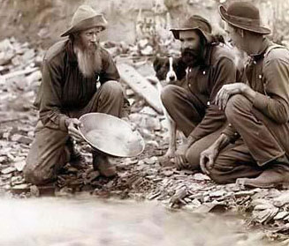
Indirect Quotations
Many writers struggle with when to use direct quotations versus indirect quotations. Use the following tips to guide you in your choice.
Use direct quotations when the source material uses language that is particularly striking or notable. Do not rob such language of its power by altering it.
If the words are gold, keep them
(i.e., use the quote(s)).
Notes:
Indirect Quotations
Indirect quotations are not exact wordings but rather rephrasings or summaries of another person's words. In this case, it is not necessary to use quotation marks. However, indirect quotations still require proper citations, and you will be commiting plagiarism if you fail to do so.
Mr. Johnson, a local farmer, reported last night that he saw an alien spaceship on his own property.
Many writers struggle with when to use direct quotations versus indirect quotations. Use the following tips to guide you in your choice.
Use direct quotations when the source material uses language that is particularly striking or notable. Do not rob such language of its power by altering it.
Martin Luther King Jr. believed that the end of slavery was important and of great hope to millions of slaves done horribly wrong.
The above should never stand in for:
Martin Luther King Jr. said of the Emancipation Proclamation, "This momentous decree came as a great beacon light of hope to millions of Negro slaves who had been seared in the flames of withering injustice."
Use an indirect quotation (or paraphrase) when you merely need to summarize key incidents or details of the text.
Use direct quotations when the author you are quoting has coined a term unique to her or his research and relevant within your own paper.
When to use direct quotes versus indirect quotes is ultimately a choice you'll learn a feeling for with experience. However, always try to have a sense for why you've chosen your quote. In other words, never put quotes in your paper simply because your teacher says, "You must use quotes."

Slide 11
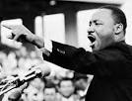
Indirect Quotations
Martin Luther King Jr. believed that the end of slavery was important and of great hope to millions of slaves done horribly wrong.
The above should never stand in for:
Martin Luther King Jr. said of the Emancipation Proclamation, "This momentous decree came as a great beacon light of hope to millions of Negro slaves who had been seared in the flames of withering injustice."

Slide 12
Indirect Quotations
Use an indirect quotation (or paraphrase) when you merely need to summarize key incidents or details of the text.
Use direct quotations when the author you are quoting has coined a term unique to her or his research and relevant within your own paper.
When to use direct quotes versus indirect quotes is ultimately a choice you'll learn a feeling for with experience. However, always try to have a sense for why you've chosen your quote. In other
words, never put quotes in your paper
simply because your teacher says,
"You must use quotes."

